Slide 1
Vizag Tourism Guide:
Travel Guide to Explore Attractions.
Shedheesh Boni

Slide 2
Exploring Venues in Visakhapatnam
Whenever a person searches for a venue in a new city, they’re highly interested in the best places that the city has to offer.
The person might want to know what are famous in that city.
This extra information would help decide which venue to choose amongst the many venues in the city, combining the location of the venues in the city and also Neighbourhoods and Landmarks would surely help visitors in a city make better informed decisions about the places they should visit.
This project explores various venues in Visakhapatnam and attributes the data based on popular restaurants along with Neighbourhoods and Landmarks .

Slide 3
Data Collection
To get location and other information about various venues in Visakhapatnam, use Foursquare API and Web Scraping to obtain the data such as Neighbourhoods and Landmarks.
Using the Foursquare’s explore API (which gives venues recommendations), I fetched venues up to a range of 10 kilometers from the center of Visakhapatnam and collected their names, categories, locations (latitude and longitude) and address.
From Foursquare API (https://developers.foursquare.com/api), I retrieved the following for each venue:
Name, Category, Latitude, Longitude, Address
Using the Beautiful Soup package I scraped Cityscapes i.e., Neighbourhoods and Landmarks data from Visakhapatnam wikipedia page.

Slide 4
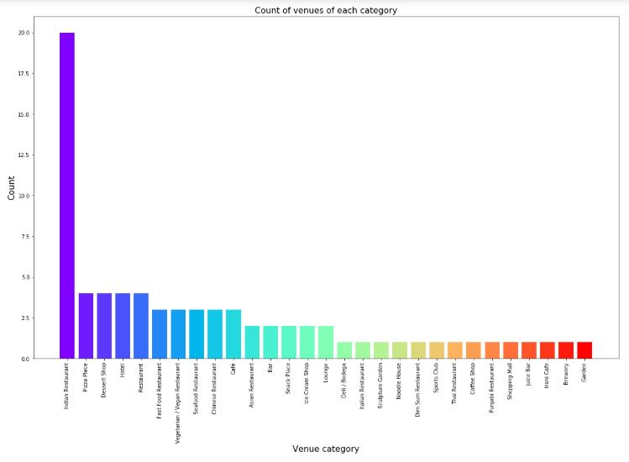
Popular restaurants in Vizag

Slide 5
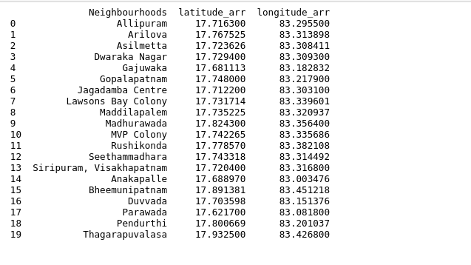
Neighbourhoods of Vizag

Slide 6
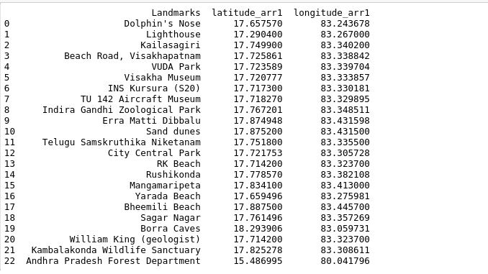
Landmarks of Vizag

Slide 7
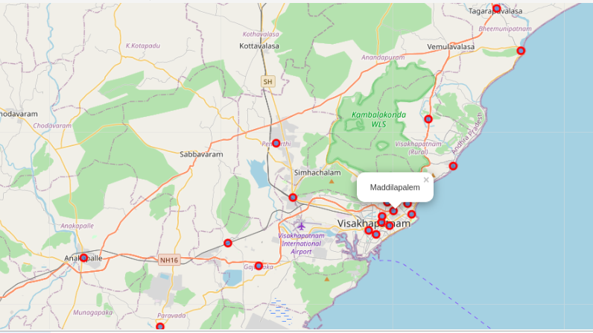
Plot showing Neighbours

Slide 8
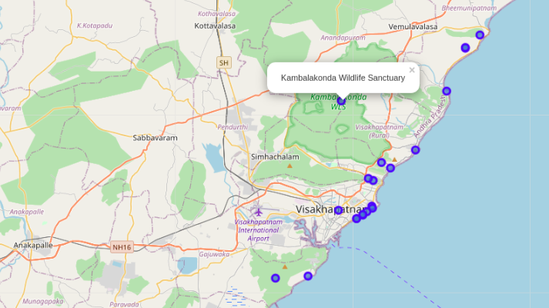
Plot showing Landmarks

Slide 9
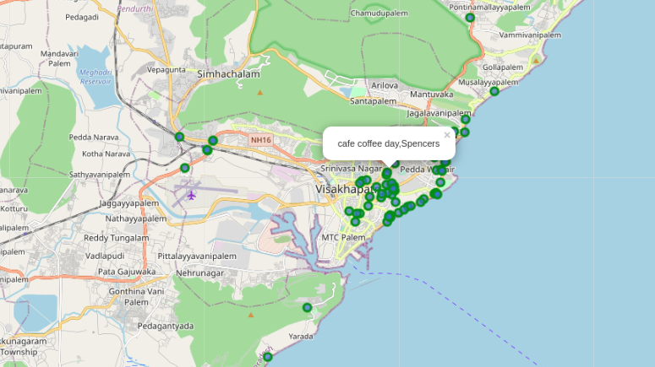
Venues in Visakhapatnam

Slide 10
Results
We identified that from the total set of venues, majority of them were Indian Restaurants. A visitor who loves Indian food would surely like to visit Visakhapatnam.
Finally, through clusters we identified that there are many venues which are clustered around 'Varun beach', 'Rk beach', 'Siripuram', 'Sampath Vinayaka temple', 'MVP colony', 'Diamond park', 'Beach road'. On the other hand, we have visualized Neighbourhoods and Landmarks.
Most of the Landmarks are scattered at the beach corridor.
If you're looking for Indian restaurants to taste Indian food Visakhapatnam can serve wide array of varieties to enjoy the food.

Slide 11
Conclusion
The purpose of this project was to explore the places that a person visiting Visakhapatnam could visit. The venues have been identified using Foursquare and have been plotted on the map along with that Neighbourhoods and Landmarks also plotted. The map reveals that there are seven major areas a person can visit: Varun beach, RK beach, Siripuram, Sampath Vinayaka temple, MVP colony, Diamond park and Beach road. Based on the visitor's reachability, he/she can choose amongst the places.
If a touristor visited beach corrider will cover up many places to be visited including popular venues and also including landmarks.

